Slide 1
Determinants of the training corpus size for clinical text classification

Slide 2
Contributors
Diana Shamsutdinova¹, Jaya Chaturvedi¹, Saniya Desphande¹, Chankai Ma³, Robert Cobb³, Angus Roberts¹, Daniel Stahl¹
¹Department of Biostatistics and Health Informatics, IoPPN;
²Department of Informatics, King's College London;
³Department of Biomedical Engineering, King's College London
https://github.com/dianashams/NLP_sample_size_simulation_study

Slide 3

Project’s background
https://github.com/dianashams/NLP_sample_size_simulation_study

Slide 4
Motivation
Manual annotation
Examples
Need for >=2 annotators
Need for clinician / domain knowledge
Time & money
Not possible to annotate more than few hundreds
Pics / diagrams

Slide 5
Sample size for text classification: previous research
Sample size problem – sample size for what? Training/ testing/ generating etc – for training size sufficient to train a good (c-index/ F1-score) classification model
What other people did and did not
Saniya’s refs
Pics / diagrams
Notes:
Clinical data and, in particular, electronic health records (EHRs), contain most information in unstructured, free-text fields and attached documents (Bean et al., 2023; Kharrazi et al., 2018; Kong, 2019) as clinicians often prefer to record information in text due to the inefficiencies of the coding systems or medical IT systems, diagnosis uncertainty or time constraints (Gao et al., 2022; Locke et al., 2021; Velupillai et al., 2018). This situation has motivated an extensive application of Natural Language Processing (NLP) techniques to clinical texts to extract information on diagnoses, symptoms, prescriptions, or health outcomes and represent it in a structured way (Cowie et al., 2017; Ford et al., 2021). The outputs are used directly to inform clinicians and patients or serve as inputs to other clinical and research models, including risk prediction models (Deshmukh & Phalnikar, 2021; Irving et al., 2021; Levis et al., 2021), trial sampling (Tissot et al., 2020), or epidemiological models (Wang et al., 2020; Yoon et al., 2022).
Most NLP models use supervised learning approach, where labelled training data is supplied for an algorithm to learn how to infer an output from a given text. The size of the training data can greatly affect the model’s performance. Sample size calculations are used to determine an optimal training data size, ensuring statistical power, result generalisability, and precision of a model’s estimates (Cohen et al., 2019). Underpowered samples may lead to biased results and hinder generalisability, consequently offering limited clinical insight. Conversely, too large sample sizes may strain resources of participants, researchers, and funding bodies (Cohen et al., 2019). Moreover, for many clinical NLP tasks, ad-hoc estimates for a sufficient sample size can be of particular importance as training data is often labelled manually, which is both costly and time consuming. Several annotators may be required to ensure the reliability and validity of annotations (S. B. Johnson et al., 2008). Further, due to the sensitive nature of the EHRs, data-holders may prefer to use as few records as possible. Nevertheless, NLP models should be sufficiently accurate to be utilised in tasks related to people’s health, and so appropriate training data is required. Therefore, clinical NLP tasks require balancing overly use of sensitive data and the model’s generalisability, for which estimating sample size is essential.
Despite these considerations, there is little guidance for sample size relating to text data. Riley and colleagues produced closed form estimates for training size of prediction models. However, these were developed for models with a limited number of predictors (Riley et al. 2019). NLP usually represents documents as high dimensional vectors, and, in some cases, the dimension is unknown in advance as it depends on total word number across all texts, which makes Riley’s approach difficult to apply. Among the few works directly considering NLP tasks, several investigated relative performance of statistical and machine learning algorithms for NLP classification tasks. One study evaluated classification accuracies of logistic regression and machine learning algorithms with respect to the training sample size for the Amazon product reviews while predicting user’s rating (Pranckevičius & Marcinkevičius, 2017). Geng and colleagues (Geng et al., 2020) tested classifiers’ performance while detecting lung disease syndromes. Both studies found that the training data should contain several thousands of documents (5000-7000) to achieve maximum performance, and that the order of magnitude did not differ between the classifiers. It is noteworthy that producing this much labelled data for an NLP classification task may be challenging. Others investigated outcome prevalence impact on the model accuracy and found that this may have an even greater influence than the size of the training data or an algorithm used (McKnight et al., 2002).
There is even less evidence of how the NLP learning curve is affected by the language properties of different domains or settings (Gu et al., 2022; Zhang et al., 2017). This can be particularly relevant for clinical NLP, where language is often domain-specific and may vary depending on the conditions being described. For instance, more common conditions may be described in multiple ways, while related terms may appear in the texts linked to patients with or without this condition. An illustrative example would be diabetes or hypertension, which are routinely checked and discussed in the context of other diseases making their descriptive vocabularies non-specific. In this case, an NLP model may need large amounts of training data to correctly identify affected patients. In contrast, rare conditions (e.g., brain tumours) can have highly specific vocabularies, with relevant words appearing mostly in the documents of the affected patients. The models may learn fast in this situation. However, the prevalence of such conditions may be low, and sample size should be adjusted to capture enough cases in a random selection of the training corpus. Moon et al. reported a similar effect for an automated acronym disambiguation in clinical texts, where the extent to which acronyms could refer to the same concept affected model performance (Moon et al. 2012). Summing up, hypothetically, both the specificity of the language describing the outcome, and the chances of encountering related words in the documents could impact models’ learning curves as training data expands. To our knowledge, no studies focused on these questions in the context of clinical NLP.
To address these gaps, our project aim was to assess the impact of training corpus parameters on sample size requirements for clinical texts classification tasks. We undertook a simulation approach in order to manipulate the parameters more easily. To ensure that the simulated corpora represented real medical documents, clinical notes from the MIMIC-III dataset (Medical Information Mart for Intensive Care) were used to calibrate the simulation parameters, including the document lengths, size of the underlying vocabularies, and frequencies of the words which are strongly, weakly, or not associated with an outcome. Texts were pre-processed using the term frequency-inverse document frequency (TF-IDF) approach . Random forest classifier was trained on both the MIMIC and simulated corpora with varying parameters to compare model performance and generate sample size recommendations.

Slide 6
Project aims
What size is sufficient
Is this worth getting more annotations (steepness)
What are the determinants in the text / language/ document properties that drive differences
Pics / diagrams
Notes:
Clinical data and, in particular, electronic health records (EHRs), contain most information in unstructured, free-text fields and attached documents (Bean et al., 2023; Kharrazi et al., 2018; Kong, 2019) as clinicians often prefer to record information in text due to the inefficiencies of the coding systems or medical IT systems, diagnosis uncertainty or time constraints (Gao et al., 2022; Locke et al., 2021; Velupillai et al., 2018). This situation has motivated an extensive application of Natural Language Processing (NLP) techniques to clinical texts to extract information on diagnoses, symptoms, prescriptions, or health outcomes and represent it in a structured way (Cowie et al., 2017; Ford et al., 2021). The outputs are used directly to inform clinicians and patients or serve as inputs to other clinical and research models, including risk prediction models (Deshmukh & Phalnikar, 2021; Irving et al., 2021; Levis et al., 2021), trial sampling (Tissot et al., 2020), or epidemiological models (Wang et al., 2020; Yoon et al., 2022).
Most NLP models use supervised learning approach, where labelled training data is supplied for an algorithm to learn how to infer an output from a given text. The size of the training data can greatly affect the model’s performance. Sample size calculations are used to determine an optimal training data size, ensuring statistical power, result generalisability, and precision of a model’s estimates (Cohen et al., 2019). Underpowered samples may lead to biased results and hinder generalisability, consequently offering limited clinical insight. Conversely, too large sample sizes may strain resources of participants, researchers, and funding bodies (Cohen et al., 2019). Moreover, for many clinical NLP tasks, ad-hoc estimates for a sufficient sample size can be of particular importance as training data is often labelled manually, which is both costly and time consuming. Several annotators may be required to ensure the reliability and validity of annotations (S. B. Johnson et al., 2008). Further, due to the sensitive nature of the EHRs, data-holders may prefer to use as few records as possible. Nevertheless, NLP models should be sufficiently accurate to be utilised in tasks related to people’s health, and so appropriate training data is required. Therefore, clinical NLP tasks require balancing overly use of sensitive data and the model’s generalisability, for which estimating sample size is essential.
Despite these considerations, there is little guidance for sample size relating to text data. Riley and colleagues produced closed form estimates for training size of prediction models. However, these were developed for models with a limited number of predictors (Riley et al. 2019). NLP usually represents documents as high dimensional vectors, and, in some cases, the dimension is unknown in advance as it depends on total word number across all texts, which makes Riley’s approach difficult to apply. Among the few works directly considering NLP tasks, several investigated relative performance of statistical and machine learning algorithms for NLP classification tasks. One study evaluated classification accuracies of logistic regression and machine learning algorithms with respect to the training sample size for the Amazon product reviews while predicting user’s rating (Pranckevičius & Marcinkevičius, 2017). Geng and colleagues (Geng et al., 2020) tested classifiers’ performance while detecting lung disease syndromes. Both studies found that the training data should contain several thousands of documents (5000-7000) to achieve maximum performance, and that the order of magnitude did not differ between the classifiers. It is noteworthy that producing this much labelled data for an NLP classification task may be challenging. Others investigated outcome prevalence impact on the model accuracy and found that this may have an even greater influence than the size of the training data or an algorithm used (McKnight et al., 2002).
There is even less evidence of how the NLP learning curve is affected by the language properties of different domains or settings (Gu et al., 2022; Zhang et al., 2017). This can be particularly relevant for clinical NLP, where language is often domain-specific and may vary depending on the conditions being described. For instance, more common conditions may be described in multiple ways, while related terms may appear in the texts linked to patients with or without this condition. An illustrative example would be diabetes or hypertension, which are routinely checked and discussed in the context of other diseases making their descriptive vocabularies non-specific. In this case, an NLP model may need large amounts of training data to correctly identify affected patients. In contrast, rare conditions (e.g., brain tumours) can have highly specific vocabularies, with relevant words appearing mostly in the documents of the affected patients. The models may learn fast in this situation. However, the prevalence of such conditions may be low, and sample size should be adjusted to capture enough cases in a random selection of the training corpus. Moon et al. reported a similar effect for an automated acronym disambiguation in clinical texts, where the extent to which acronyms could refer to the same concept affected model performance (Moon et al. 2012). Summing up, hypothetically, both the specificity of the language describing the outcome, and the chances of encountering related words in the documents could impact models’ learning curves as training data expands. To our knowledge, no studies focused on these questions in the context of clinical NLP.
To address these gaps, our project aim was to assess the impact of training corpus parameters on sample size requirements for clinical texts classification tasks. We undertook a simulation approach in order to manipulate the parameters more easily. To ensure that the simulated corpora represented real medical documents, clinical notes from the MIMIC-III dataset (Medical Information Mart for Intensive Care) were used to calibrate the simulation parameters, including the document lengths, size of the underlying vocabularies, and frequencies of the words which are strongly, weakly, or not associated with an outcome. Texts were pre-processed using the term frequency-inverse document frequency (TF-IDF) approach . Random forest classifier was trained on both the MIMIC and simulated corpora with varying parameters to compare model performance and generate sample size recommendations.

Slide 7
Preliminary research
by Saniya Deshpande, MSc, with DS supervision

Slide 8

Methods
Dataset used: publicly available MIMIC-III dataset
Pre-processing: lowercasing, remove symbols
Training: binary classification task to identify diagnosis code
Varied training corpus size to investigate learning curves
Examined impact of vocabulary properties on learning curves

Slide 9

Methods
Other tasks:
Tested question-answering with LLMs (name the models..)
Compared vocabulary sizes for each class (0 vs 1)
Analyzed n-grams and vectorized data using TF-IDF
Ran logistic regression to identify predictive words
Extracted feature names and coefficients
Plotted model coefficients
Applied SHAP for model interpretation

Slide 10



Question Answering
Models used..
Example prompt…

Slide 11
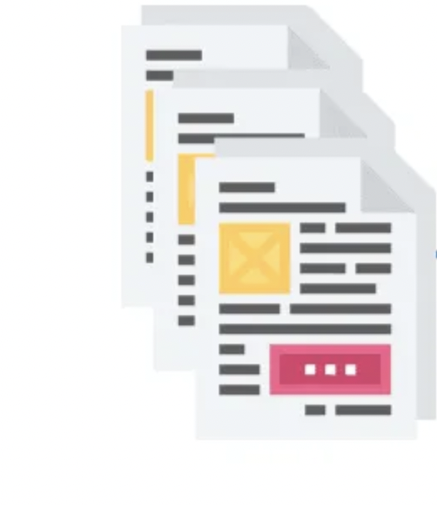
Logistic Regression
Text is vectorized and transformed
And then fit to a logistic regression model
Coefficients of the features are extracted and plotted
Set threshold of 0.1 and those above it are counted as high weight features. Total features counted as well.
Then SHAP linear explainer used to calculate the contribution of each feature to the model's prediction
Also visualized the impact of various features on each class and overall usign SHAP plots
Histogram of coefficients plotted and counted number of non zero coefficients\
Also used eli5 to identify features contributing to each class

Slide 12

Vocab size
For vocab size- documents were tokenized and lower cased - split by label and counted

Slide 13
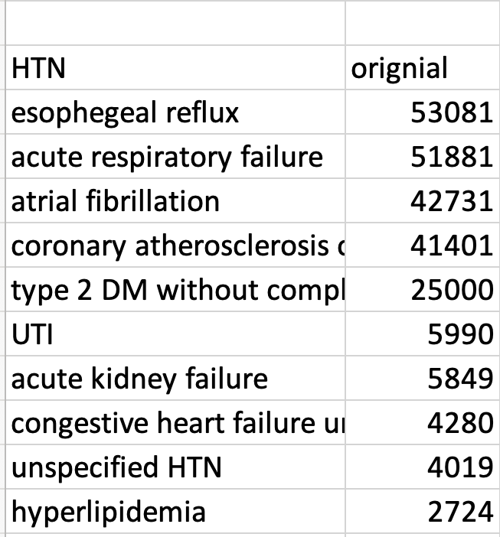
Diagnosis codes used

Slide 14
Results
learning curves of the classification models of different diagnoses varied significantly, despite them using the same underlying preprocessing methods and models.
Vocabulary complexity analysis inconclusive in explaining differences
Half of the modelled outcomes did not reach accuracy of 0.70 or above even with the 10,800 documents (the maximum training size in the experiments).
Performance plateaued at sample sizes between 1,000-5,000 documents
For 10 out of 11 diagnoses, n=600 achieved 95% of performance possible with n=10,000

Slide 15
Results
'Original' dataset showed unusually steep learning curve (outlier)
Less noisy texts consistently showed strong predictors
Clear pattern of more strong predictors and fewer noisy predictors associated with higher AUC-max
an increase of 100 noisy words corresponds to a decrease of approximately 0.02 in AUC-max
an increase of 100 strong predictors corresponds to an increase of approximately 0.04 in AUC-max.

Slide 16
Implications
Simple keyword analysis can indicate learning curve steepness
Data cleaning techniques focusing on relevant document parts can significantly impact performance
Understanding predictor-noise-AUC relationship can guide optimal sample size decisions
Quantitative guidelines can estimate potential improvements from data cleaning or additional data
Pics / diagrams

Slide 17
Future work and limitations
Ongoing analysis of text properties underlying learning curve differences
Exploring key word frequencies and distances in LLM document representations
Modern generative methods for increasing training data not explored (out of scope)
Future directions to investigate more sophisticated text analysis techniques

Slide 18
Conclusions
Pics / diagrams

